Slide 1

Gouvieux Winter Edition 2018
Azure AD B2C in vogelvlucht Jurgen van den Broek

Slide 2
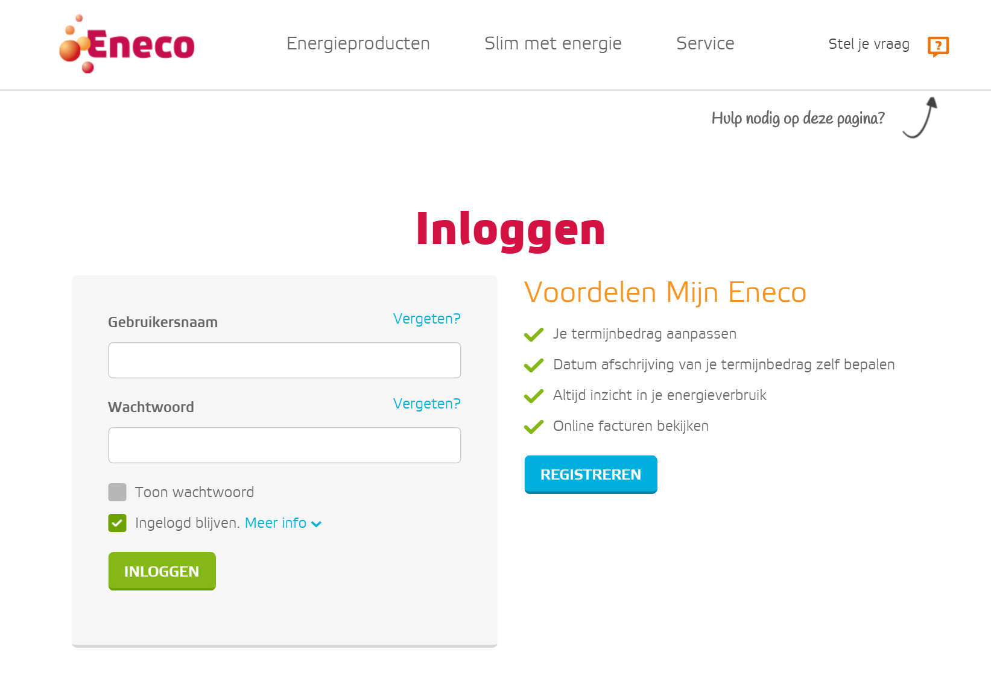
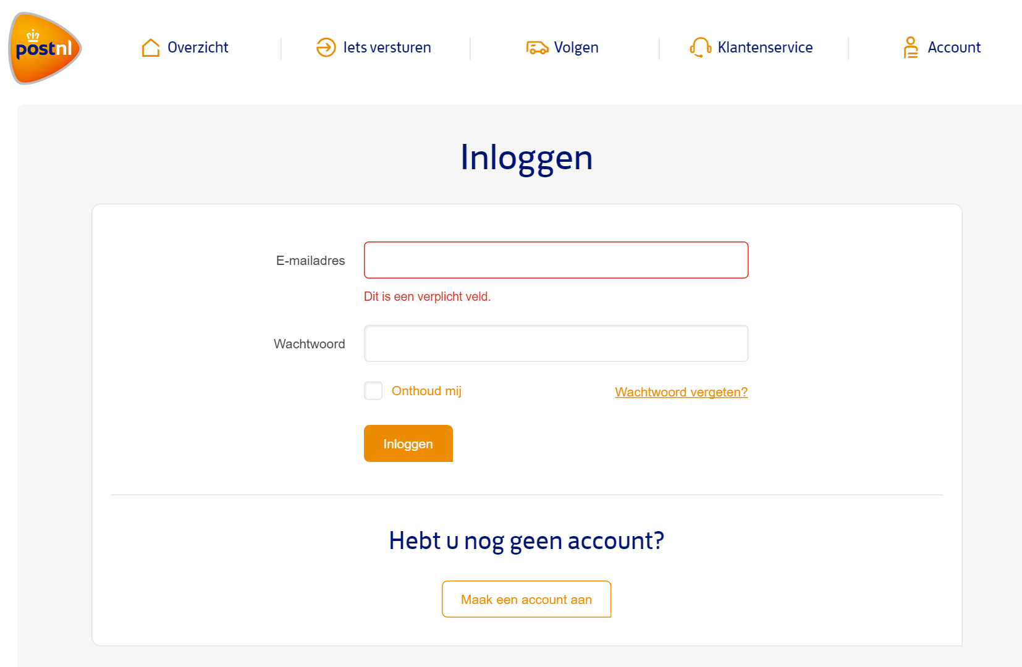
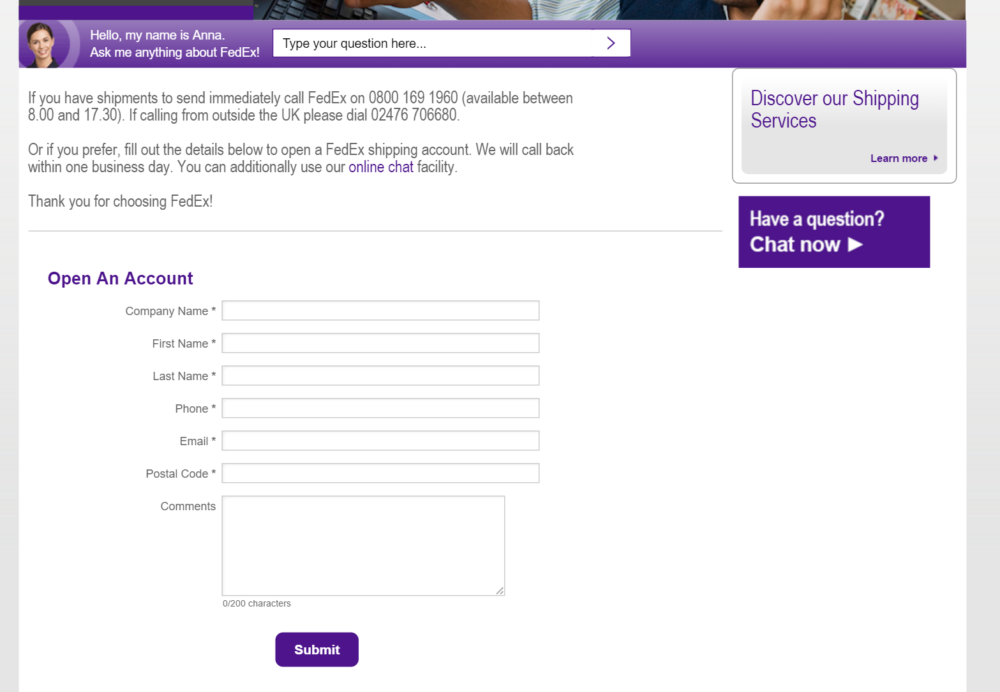
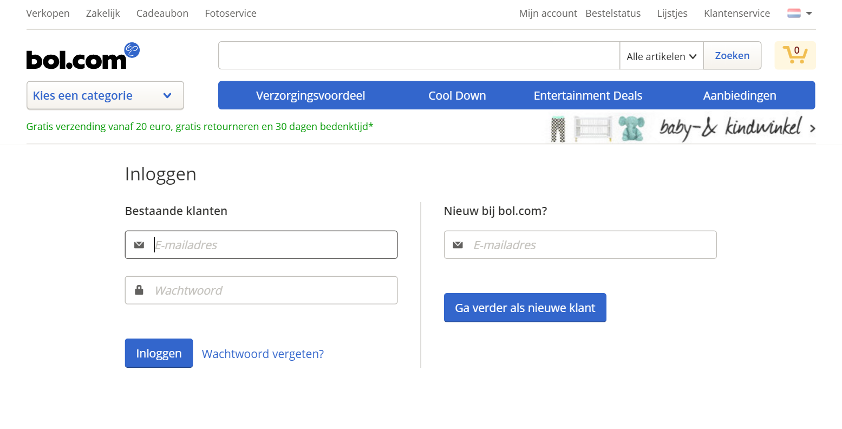
Customer identity cases

Slide 3



Azure AD B2c
One Identity
Security
Standardize
Single Sign-on solution for all customer facing web applications and apps.
Standardized login and registration flows without the need of a custom solution.
Keeps your customer’s data secure.

Slide 4
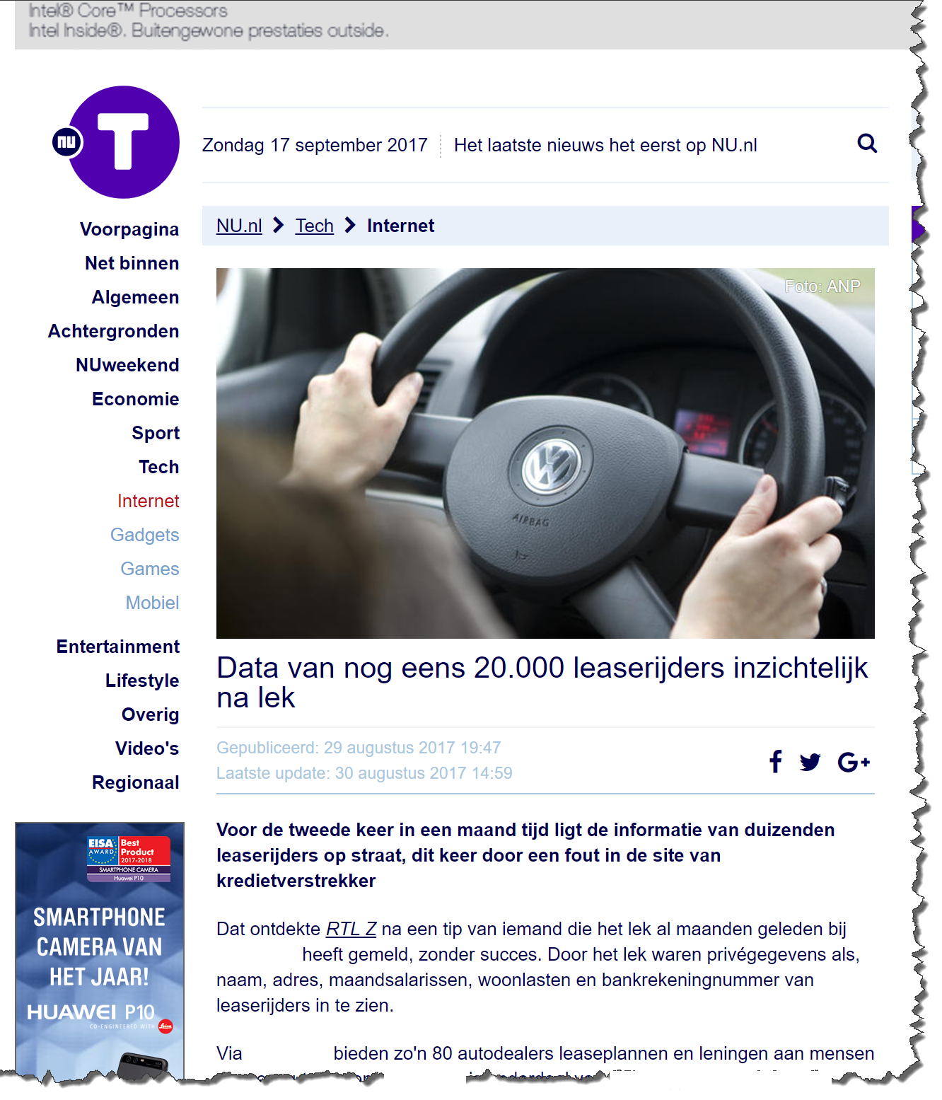
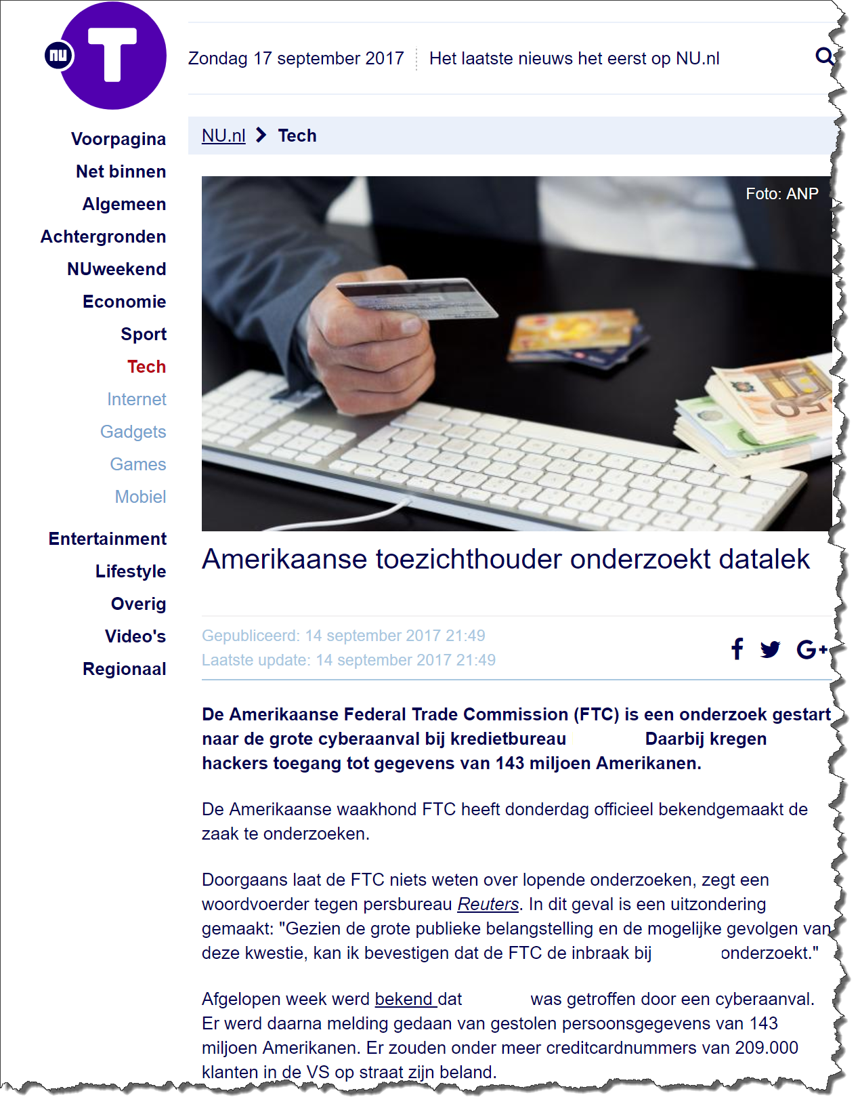
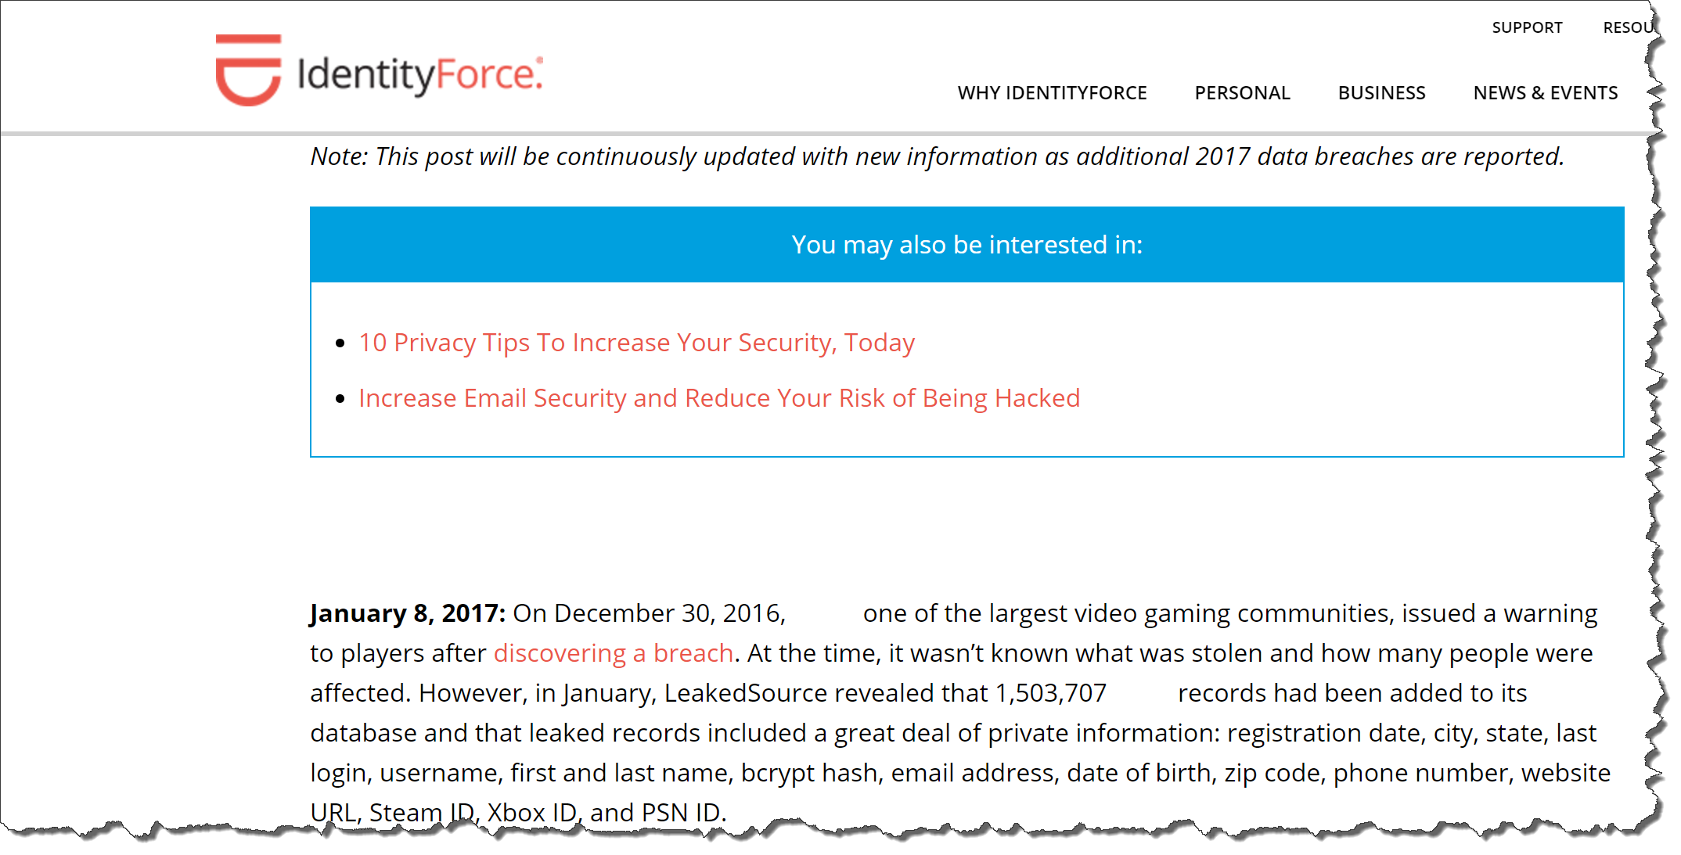
Security

Slide 5
Azure AD B2c
One Identity
Security
Standardize
Single Sign-on solution for all customer facing web applications and apps.
Standardized login and registration flows without the need of a custom solution.
Keeps your customer’s data secure.

Slide 6


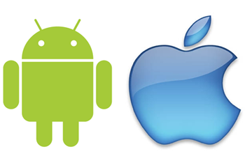
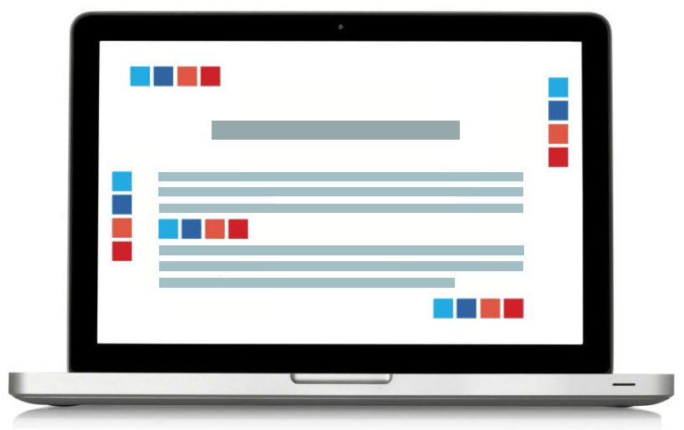
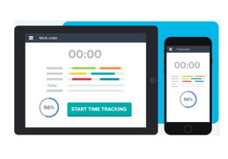

One Identity
?

Slide 7
Azure AD B2c
One Identity
Security
Standardize
Single Sign-on solution for all customer facing web applications and apps.
Standardized login and registration flows without the need of a custom solution.
Keeps your customer’s data secure.

Slide 8
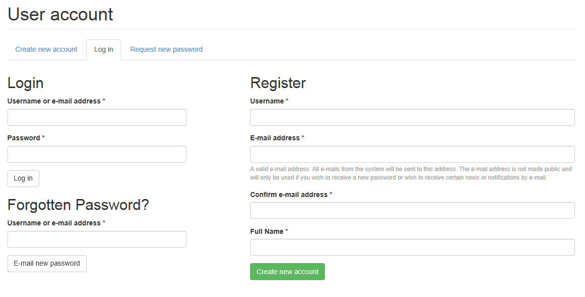
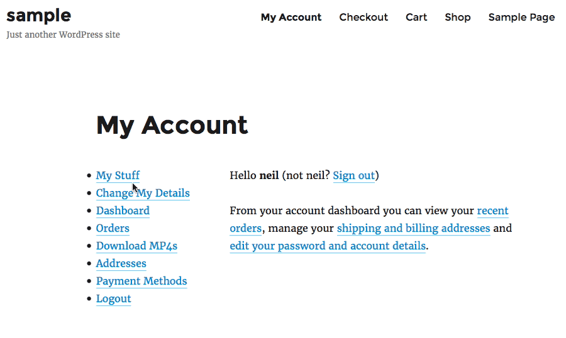
Standardize

Slide 9
Comparing
Azure Active Directory
Identity Provider
Focus on self-service
Enterprise identities
HR
Auto-provisioned
License per user
Azure Active Directory B2C
Identity Provider
Focus on self-service
Customer identities
CRM
Self-registration
Price per user / authentication

Slide 10

CONTENTS
PART01
PART02
Built-in policies
Custom policies
PART03
PART04
Identity providers
Localization

Slide 11




Demo
Environment
Azure AD B2C tenant
Social Identity provider
Azure Active Directory
Web application
Azure AD B2C
Azure AD

Slide 12
Built-in Policies

Slide 13
Policies
Protocols & tokens
OpenID Connect and OAuth 2.0
JWT tokens
Policies
Sign-in policy
Sign-up policy
Sign-up or sign-in policy
Profile editing policy
Password reset policy
Identity Provider
Attributes and Claims
Token and Session
Branding
Azure AD B2C

Slide 14




Social Identity Providers
Microsoft
Amazon
Google
Facebook
LinkedIn
..?
Azure AD B2C

Slide 15
Demo

Slide 16
Custom Policies

Slide 17
Custom Policies
Base policy
Includes the core claims schema, claims transformations, claims providers, and user journeys configured by Microsoft.
Base Policy
Extension policy
Consolidate your changes to the BASE file here, Modified claims providers, Modified user journeys, Your own custom schema definitions.
Extension Policy
Relying Party policy
RP
Policy
Change token shape and session settings here.

Slide 18
Demo

Slide 19
Identity Providers

Slide 20
Identity Providers
Customer
Corporate
Custom Identity Provider
Federate Azure AD B2C with your own Identity Provider.
Protocols
Custom IdP
The protocols SAML, OpenID Connect and OAUTH are supported.
Azure AD B2C
Enterprise Scenario
Let corporate identities login into your customer applications.

Slide 21
Demo

Slide 22
Localization

Slide 23
Localization
Language customization
Allows you to select which languages your user journey is available in.
UI-locales setting
Supported language
Browser language
Azure AD B2C supports 36 language translations.
Customization
Policy language
Customize the language content files for your customer journey.

Slide 24
Demo

Slide 25
@juvdbroek
www.identityandcloud.com

